Slide 1
Fraternal programs
Notes:
Welcome, everyone! Thanks for attending this chapter educational event.
Since you’re here, you may be somewhat familiar with Modern Woodmen of America chapters. Chapters are local groups of Modern Woodmen members who come together to:
• Impact the community and help those in need.
• Discover new places and learn new things.
• Meet and build friendships with other local members.
• And have fun!
Chapters are part of what makes Modern Woodmen unique as a fraternal financial services organization. “Fraternal” is a somewhat unknown word, but it’s at the heart of Modern Woodmen. In part, it means we were built for our members’ benefit, not for stockholders.
Question: Show of hands, who here is a Modern Woodmen member? [pause for show of hands]
Question: Who doesn’t know what a member is? [pause for show of hands]
Simply put, when you join Modern Woodmen, you become a member of the organization.
• Members support Modern Woodmen’s emphasis on financial security, quality family life and community impact.
• They can trust Modern Woodmen for help with their financial needs, such as life insurance and retirement planning.
• They can also access a variety of fraternal programs.
That’s what we’re here to talk about today/tonight. Chapters are a key fraternal program that members nationwide can enjoy. But chapters aren’t the ONLY program.
Today/tonight let’s become more familiar with other programs available to Modern Woodmen members.

Slide 2

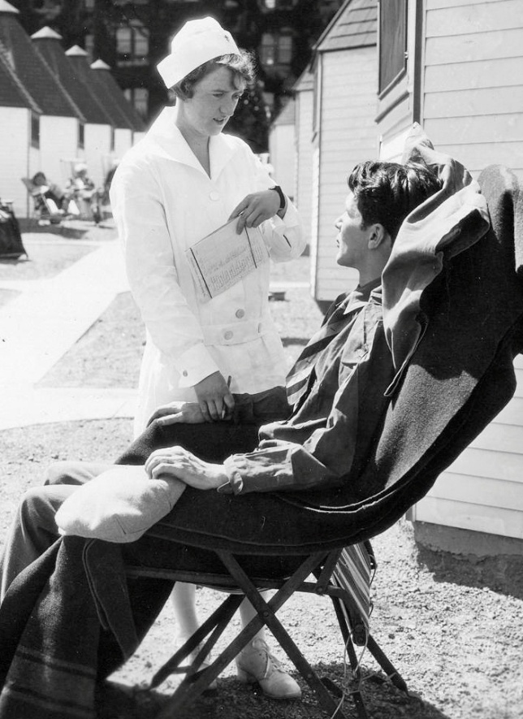
Fraternal programs history
Tuberculosis sanatorium.
Free treatment for members.
75% recovery rate.
Notes:
Let’s start at the beginning.
Modern Woodmen’s very first fraternal program included treatment at its tuberculosis sanatorium. (In case you’re wondering, a sanatorium is a hospital that treats chronic diseases like tuberculosis.)
In fact, at the turn of the 20th century, tuberculosis – also known as the “white plague” or consumption – was the leading cause of death for Modern Woodmen members. In response, Modern Woodmen opened a tuberculosis sanatorium in Woodmen, Colorado – just north of Colorado Springs in 1909. Any beneficial member with tuberculosis could receive treatment at the sanatorium free of charge.

Slide 3

Fraternal programs today
Notes:
Note: Pass out Form 453 – Get the most of your membership
Fast-forward to today. We offer several programs that help members and their families in good times and times of need. This handout briefly describes each of them. You may want to mark the ones you’re most interested in as I describe them.

Slide 4

Birthday Book Club
Free books for kids during their birthday month, up to age 12.
Households where the child and least one parent are beneficial members.
Available through Modern Woodmen reps.
Notes:
Question: What is/was your favorite childhood book?
The Birthday Book Club provides free, age-appropriate books for children up to age 12. To be eligible, the child and at least one parent or legal guardian must be beneficial Modern Woodmen members. (That means they have Modern Woodmen life insurance or annuity coverage.)
The age-appropriate, high-quality books feature classic tales, contemporary fiction and educational resources. They’re mailed directly to children’s homes during their birthday months each year in a fun box that also includes interactive activities.
This program is available primarily through your Modern Woodmen representative, or you can complete an application by logging into your online member account at member.modernwoodmen.org.

Slide 5
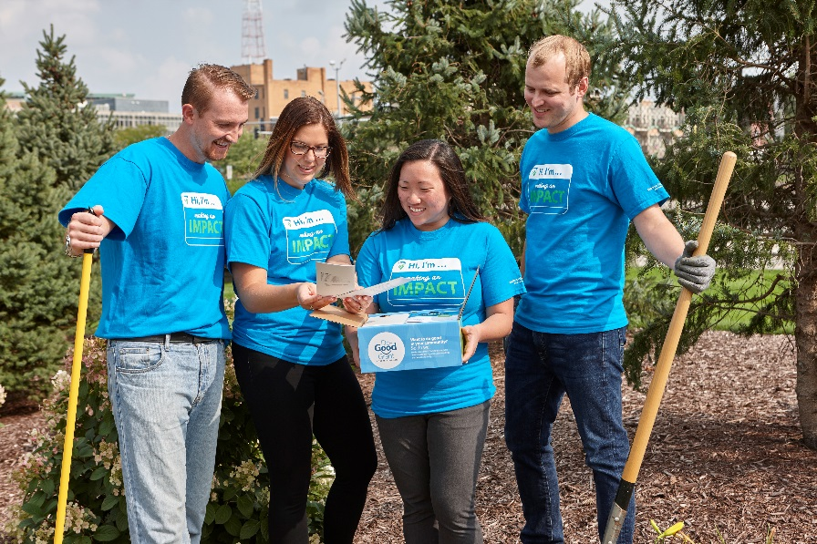
Do-Good Grant ®
For beneficial members ages 13 and over.
$200 for hands-on service project.
One per household annually.
Notes:
Modern Woodmen’s Do-Good Grant® is all about supporting causes you personally care about. As a member, you can receive $200 in seed money to help you conduct a small, hands-on volunteer project with your family and friends. You choose the project and the cause that it will benefit.
Question: What good would you do with a $200 grant?
You can apply for a grant through your online member account at member.modernwoodmen.org.

Slide 6


Final Wishes Resources
Help for late-in-life and end-of-life planning.
My Life, My Plan workbook.
My Life, My Plan – A Helper’s Guide
Contact your rep.
Notes:
Late-in-life and end-of-life planning is important. Some people may be reluctant to discuss the topic with their loved ones, but doing so can clear up confusion and anxiety.
The Final Wishes Resources program offers help for both sides of the conversation. You can choose from two handy (and free!) resources, available exclusively to Modern Woodmen members.
The My Life, My Plan workbook is an easy-to-follow guide that breaks late-in-life/end of-life planning down into manageable, bite-size chunks. Work through defined steps to help get your house in order, organize your affairs and record your wishes for your loved ones.
My Life, My Plan – A Helper’s Guide provides advice for those who want to help a parent, spouse, relative or friend prepare final wishes. The guide offers tips for holding end-of-life planning conversations and helps prepare you for the eventual loss of a loved one.
Question: Has anyone ordered the workbook or the guide?
Talk to your Modern Woodmen rep to order one or both resources. Or request through your online member account at member.modernwoodmen.org.

Slide 7

Financial Relief Fund
Life insurance premiums covered for three months.
Accident, illness, fire, natural disaster or medical emergency.
Proof of financial hardship.
Can apply twice in five years.
Notes:
When disaster strikes, resources get tight, but Modern Woodmen believes life insurance protection is crucial.
The Financial Relief Fund could help. It’s here for members who experience significant financial hardship due to natural disasters – such as storms, floods and fires – or due to an accident, illness or medical emergency. Affected members who find it difficult to keep their life insurance in force may qualify to have their premium payments covered for three months.
If approved, Modern Woodmen will apply financial relief to all life insurance certificates owned and paid for by the member and their spouse.
[If time allows, ask if anyone has experience with the Financial Relief Fund and would be willing to share. Note: These stories can be very personal. Make sure the audience knows there’s no pressure to share.]

Slide 8

Scholarship Program
198 one-time scholarships for graduating high school seniors.
$450,000 awarded each year!
Notes:
Modern Woodmen awards $450,000 each year in a scholarship competition for high school seniors. These scholarships help with the rising cost of higher education, while recognizing our young members’ hard work and volunteer service. Whether a student's next stop is college or trade school, they are eligible to apply.
Each year, 198 graduating seniors win up to $10,000. An independent panel of judges select 33 winners from each of six geographic regions.
Since the competition is open exclusively to Modern Woodmen member students, the odds of winning are greater than many national award programs.
To be eligible, students must be covered by Modern Woodmen life insurance or an annuity for at least one year as of Jan. 1 of their graduating year of high school.

Slide 9

Scholarship Program
$1,000 to help with the educational pursuits of high school grads 21 and up!
Notes:
Modern Woodmen also awards 150 scholarships of $1,000 each to qualified members 21 and older.
The scholarship can be used toward the cost of:
Undergraduate or graduate-level study at an accredited two- or four-year college or university.
Trade, vocational or technical school.
You can find complete details about both competitions – including a link to the online application – when you log in to your online member account at member.modernwoodmen.org.

Slide 10

Modern Woodmen Travels
Each trip offers attendees:
Discounted group rate.
Exclusive events with other members across the country.
Unique community impact experience tied to the culture of the destination.
Notes:
Did you know, members can attend special trips to exciting destinations, hosted by Modern Woodmen? This fraternal program is called Modern Woodmen Travels. Each trip offers attendees:
A discounted group rate.
Exclusive events with other members across the country.
And a unique community impact experience tied to the culture of the destination.
As an added bonus, Modern Woodmen does all the planning!
These travel experiences are open to all Modern Woodmen members. However, age and other requirements may apply, depending on the individual trip. That’s because destinations and activities are chosen with specific groups of members in mind. It’s part of what makes the experience memorable and unique.

Slide 11
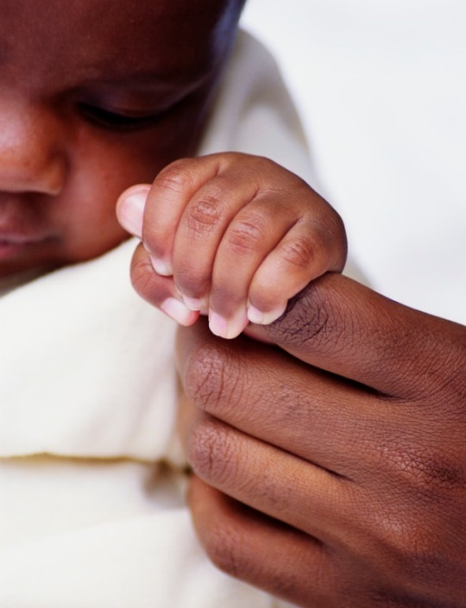
Newborn Life Insurance Benefit
For parents of infants in poor health.
Life insurance – issued at standard rates, regardless of health.
Additional coverage as adult.
$10,000 in case of tragedy.
Notes:
Giving birth to an infant in poor health is one of the scariest things a new parent may face. The Newborn Life Insurance Benefit can’t take the scary away, but it can lessen some financial anxiety. It helps ensure member parents can obtain $10,000 of permanent life insurance their newborn can build on as an adult ... at standard rates, regardless of the child's current or future health.
As a second part of this member program, the Newborn Life Insurance Benefit provides automatic financial support to qualifying families who suffer the loss of an infant within the first six months. The benefit provides $10,000 to assist with the newborn’s funeral or medical costs.
To qualify for the Newborn Life Insurance Benefit, at least one parent must have been covered by Modern Woodmen life insurance or an annuity for six months prior to the child’s birth.

Slide 12

Orphan Support Benefit
For members’ children
orphaned before age 19.
Monthly payments
of $700 per child.
Payments continue
through childhood.
$50,000 education grant.
Notes:
No one wants to think about leaving their kids without parents, but it happens. Modern Woodmen provides financial support for the care and education of qualifying children who become orphaned. The new legal guardian receives monthly payments of $700 for each child through age 18.
Payments begin one month after approval by Modern Woodmen. They continue until the orphan becomes self-supporting, marries, reaches age 19, or enrolls in college under the Orphan Support Benefit’s education grant. The grant pays $50,000 (up to $12,500 each school year) to an accredited college, university or vocational institution.
To be eligible, the child or last surviving legal parent must have been covered by Modern Woodmen life insurance or an annuity for six months preceding the parent’s death.

Slide 13

PerkSpot
Exclusive discount hub.
View by:
  Category.
  Brand.
  Preferences.
Notes:
Switching gears completely, we have PerkSpot.
PerkSpot is an online discount hub for some of our members’ favorite national and local merchants. Members can save on thousands of products, services and experiences – from electronics, apparel and food to pet supplies, entertainment, travel and more.
Members can view discounts by category, brand or preferences and use the local map tool to discover discounts near them.

Slide 14

Terminal Illness Interest Relief
Rider required.
Up to $5,000 lien interest waived in first year.
Automatically applied as one-time payment.
Notes:
Qualifying members diagnosed with a terminal illness can receive a portion of their life insurance proceeds in advance. This money can be used to help with medical costs and alleviate other immediate financial worries.
The advance is treated as a lien against the contract and requires the member to pay interest. However, through the Terminal Illness Interest Relief program, Modern Woodmen will pay up to $5,000 of the accrued interest on the lien.
This program is available to beneficial members who elect to use the accelerated benefits rider or terminal illness accelerated benefit rider attached to their certificate. Accelerated benefits are not available in all states or situations.

Slide 15
Access these fraternal programs
Go to member.modernwoodmen.org.
Talk to your Modern Woodmen representative.
Call the Service Center
at 309-558-3077 or 800-447-9811.
Notes:
Now that you know more about the fraternal programs available to members, how do you access them?
You have several options.
Log in to your online member account at member.modernwoodmen.org and go to the Member Programs section. You can find complete details about all of the programs available and access application forms for many of them.
Talk to your local Modern Woodmen representative, who can answer questions about them and will be happy to help you with your request.
Call the Service Center at Modern Woodmen’s headquarters at 309-558-3077 or 800-447-9811. Service Center representatives are available 8:00 a.m.-4:30 p.m., Monday through Friday, Central time.

Slide 16
Thank you for coming!
Subject to change, these fraternal programs are
not part of the insurance contract and may have specific eligibility requirements. Some programs
are not available to all members.
Form 747 (Rev. 7-25)
Notes:
Thanks again for joining us [today/tonight].
We look forward to seeing you at our next chapter event! [Offer the time and place. Insert any housekeeping comments as appropriate.]

