Slide 1
Compensation Forms
for chapter and Summit chapter
activities coordinators

Slide 2
The purpose of the Compensation Form is to report how leader compensation paid to the chapter was allocated.
How much was paid to the activities coordinator?
How much was paid to another individual(s)?
How much was donated to the chapter and not paid out?

Slide 3
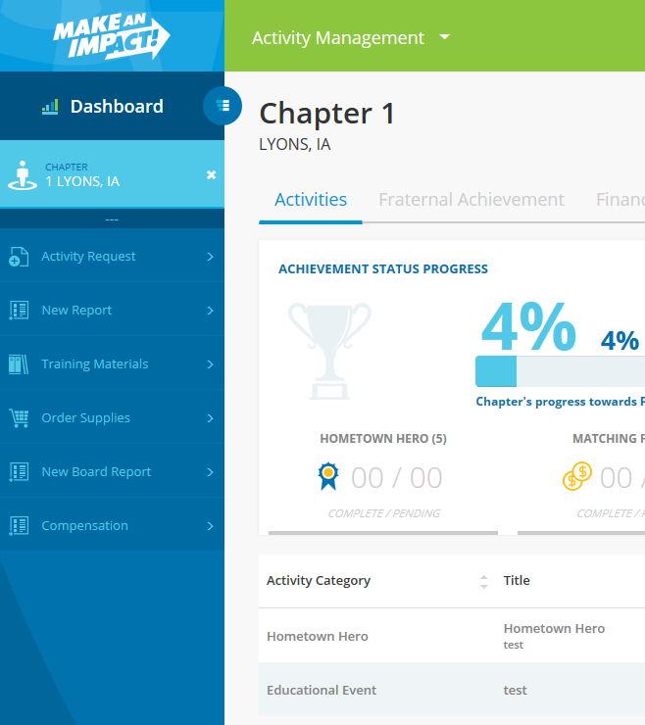
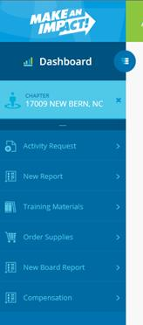
1. Access the Compensation form at imakeanimpact.org.
Can’t see the compensation form? Click on the dashed line to collapse the chapter/club information and view additional links.
Notes:
Examples of posts gone bad.

Slide 4
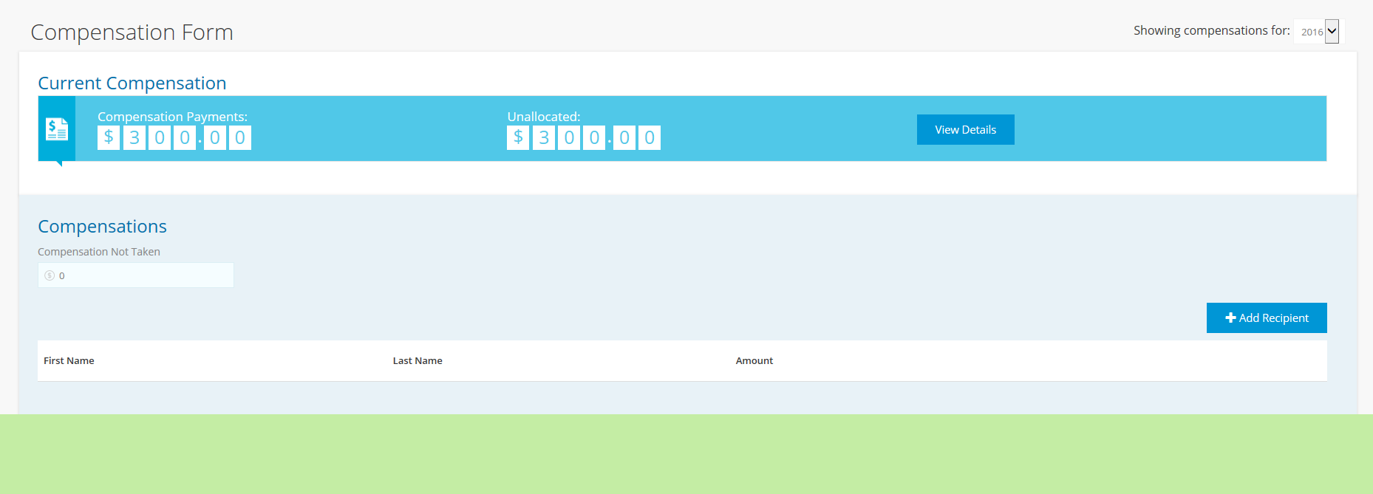
2. After each leader compensation payment, allocate the funds from that payment.
Notes:
Examples of posts gone bad.

Slide 5
You can view the details of the payment(s) included in the unallocated amount.
Notes:
Examples of posts gone bad.

Slide 6
3. If funds were donated to the chapter and not paid to anyone, indicate that amount in the Compensation Not Taken field.
Notes:
Examples of posts gone bad.

Slide 7
4. To allocate compensation to an individual, select Add Recipient.
Notes:
Examples of posts gone bad.

Slide 8
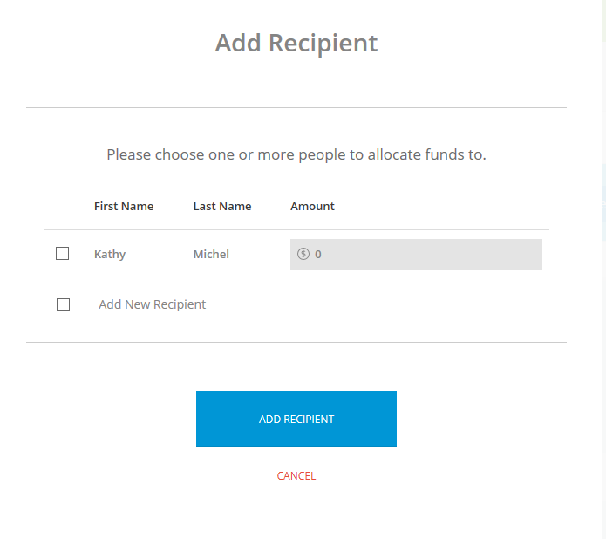
5. Indicate the amount (if any) that was paid to the activities coordinator.
Notes:
Examples of posts gone bad.

Slide 9
6. If compensation was paid to another individual, select Add New Recipient and click Continue.
Notes:
Examples of posts gone bad.

Slide 10
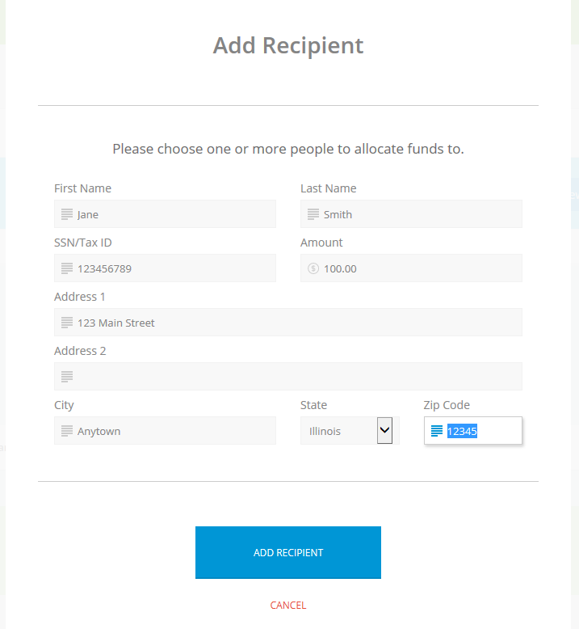
7. Complete the fields about the additional recipient. Please make sure all information is accurate!
Notes:
Examples of posts gone bad.

Slide 11
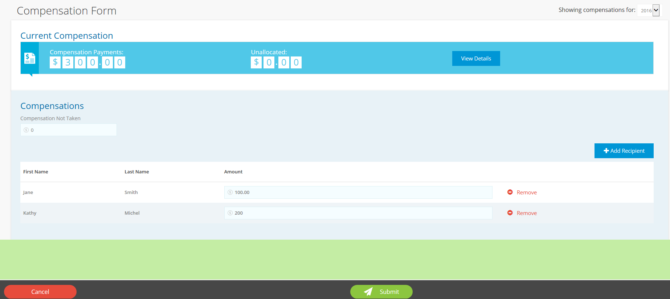
8. Review the information on the form, and verify the Unallocated field shows $0.
Notes:
Examples of posts gone bad.

Slide 12
9. Click Submit to confirm the allocation.
**Note that this allocation may not be updated or changed once you submit the form.**
Notes:
Examples of posts gone bad.

Slide 13
Additional information:
Repeat this process after each leader compensation is paid throughout the year.
All funds must be allocated by Dec. 31 of the current tax year.
Any funds unallocated after Jan. 1 will be allotted to the current activities coordinator.
Each individual who receives more than $600 from a chapter or Summit chapter will be sent a 1099M tax form for that tax year.

